Slide 1
Polymorphism
Course Code: CSC 2210
Course Title: Object Oriented Programming 2
Dept. of Computer Science
Faculty of Science and Technology
Lecturer No: | 05 | Week No: | 05 | Semester: | Fall 2023-24
Lecturer: | Noboranjan Dey; noboranjan@aiub.edu

Slide 2
Topics
Polymorphism
Method Overriding
Method Overloading

Slide 3
Polymorphism
Polymorphism originates from the greek word “polys” which means many, and “morphe” which means forms, or shapes.
Polymorphism is possible when classes share a common interface. For example, a Cat class and a Dog class may share a common interface through inheriting the Animal class.
To understand Polymorphism, we must take a look at how we instantiate objects.
Cat myCat = new Cat();
Here we declare the reference type Cat, the variable name myCat and instantiate a new Cat object by calling new Cat();

Slide 4

Polymorphism
When classes share a common interface, we can redefine the reference type of the objects we are creating. So our myCat definition can be changed to:
Animal myCat = new Cat();
For example, we can now create an Array of Animals that can contains Dog objects, Cat objects and any other subclass of Animal.
Animal[] animals = new Animal[2];
animals[0] = new Cat();
animals[1] = new Dog();
Polymorphism is a very powerful concept that improves code extensibility and modularity.

Slide 9
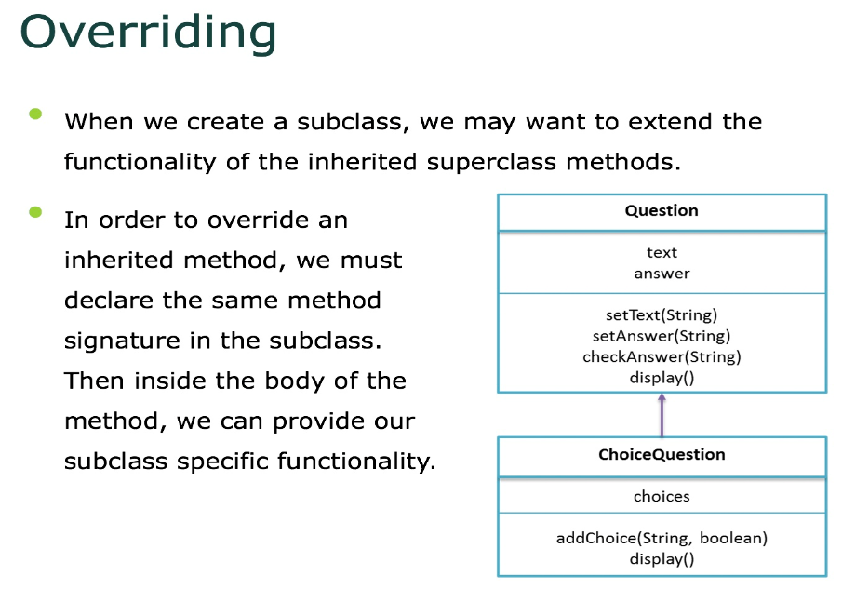

Slide 10
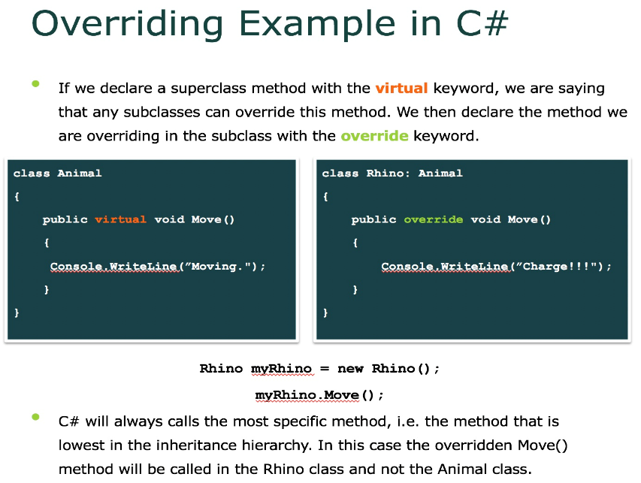

Slide 11
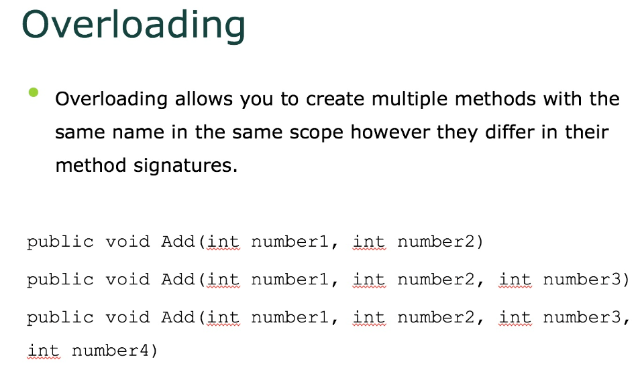

Slide 12
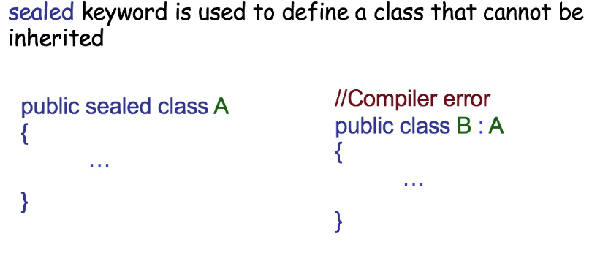
Sealed keyword

Slide 13

Thank You

Slide 14
Books
C# 4.0 The Complete Reference; Herbert Schildt; McGraw-Hill Osborne Media; 2010
Head First C# by Andrew Stellman
Fundamentals of Computer Programming with CSharp – Nakov v2013

Slide 15
References
MSDN Library; URL: http://msdn.microsoft.com/library
C# Language Specification; URL: http://download.microsoft.com/download/0/B/D/0BDA894F-
2CCD-4C2C-B5A7-4EB1171962E5/CSharp%20Language%20Specixfication.doc
C# 4.0 The Complete Reference; Herbert Schildt; McGraw-Hill Osborne Media; 2010

